Slide 1
Computer Graphics
UNIT 2
Graphics Output Primitives
Dr. Pallavi Pratap

Slide 2
Basic Raster Algorithms for 2D Primitives
Description of pictures
  Specified by a set of intensities for the pixel positions.
  Describe it as a set of complex objects, such as trees, furniture and walls, positioned at specific coordinate locations within the scene.
  Graphics programming packages provide functions to describe a scene in terms of basic geometric structures referred to as output primitives.
    Points
    Straight lines
    Circles
    Splines curves and surfaces
    Polygon color areas
    Character strings
    Etc.

Slide 3
Implementing Application programs
Scan Conversion:
The process of representing graphical objects as a collection of pixels.(Rasterization)
  Primitives – what is to be generated
  Attributes – how primitives are to be generated

Slide 4
Points
(0,0)
CRT
(maxx,maxy)
The electron beam is turned on to illuminate the phosphor at the selected location (x, y) where
0 ≤ x ≤ maxx
0 ≤ y ≤ maxy
setpixel(x, y, intensity) – loads an intensity value into the frame-buffer at (x, y).
getpixel(x, y) – retrieves the current frame-buffer intensity setting at position (x, y).

Slide 5
Lines
Analog devices, such as a random-scan display or a vector plotter, display a straight line smoothly from one endpoint to another. Linearly varying horizontal and vertical deflection voltages are generated that are proportional to the required changes in the x and y directions to produce the smooth line.

Slide 6

Digital devices display a straight line by plotting discrete coordinate points along the line path which are calculated from the equation of the line.
  Screen locations are referenced with integer values, so plotted positions may only approximate actual line positions between two specific endpoints.
  A computed line position of (10.48, 20.51) will be converted to pixel position (10, 21). This rounding of coordinate values to integers causes lines to be displayed with a stairstep appearance (the “jaggies”).
  Particularly noticeable on systems with low resolution.
  To smooth raster lines, pixel intensities along the line paths must be adjusted.

Slide 7
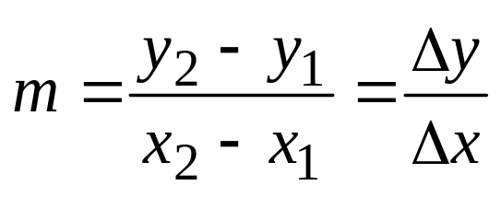
Line Drawing Algorithms
Cartesian equation:
y = mx + c
where
  m – slope
  c – y-intercept
y₂
y₁
x₁
x₂

Slide 8
Slope
+ve
-ve
if |m| = 1
  θ = 45°
45°
45°
if |m| < 1
  -45° < θ < 45°
θ°
θ°
if |m| > 1
  45° < θ < 90° or
  -90° < θ < -45°
θ°
θ°

Slide 9
|m| = 1
y = x
m = 1
c = 0
y
x | y
0 | 0
1 | 1
2 | 2
3 | 3
4 | 4
5 | 5
6 | 6
7 | 7
8 | 8
8 |  |  |  |  |  |  |  |  | ■
7 |  |  |  |  |  |  |  | ■
6 |  |  |  |  |  |  | ■
5 |  |  |  |  |  | ■
4 |  |  |  |  | ■
3 |  |  |  | ■
2 |  |  | ■
1 |  | ■
0 | ■
 | 0 | 1 | 2 | 3 | 4 | 5 | 6 | 7 | 8
x

Slide 10
|m| < 1
y = ½ x + 1
m = ½
c = 1
y
8
7
6
5 |  |  |  |  |  |  |  | ■ | ■
4 |  |  |  |  |  | ■ | ■
3 |  |  |  | ■ | ■
2 |  | ■ | ■
1 | ■
0
 | 0 | 1 | 2 | 3 | 4 | 5 | 6 | 7 | 8
x | y | round(y)
0 | 1 | 1
1 | 1.5 | 2
2 | 2 | 2
3 | 2.5 | 3
4 | 3 | 3
5 | 3.5 | 4
6 | 4 | 4
7 | 4.5 | 5
8 | 5 | 5
x

Slide 11
|m| > 1
y = 3x - 2
m = 3
c = -2
y
8
7 |  |  |  | ■
6
5
4 |  |  | ■
3
2
1 |  | ■
0
 | 0 | 1 | 2 | 3 | 4 | 5 | 6 | 7 | 8
x | y | round(y)
0 | -2 | -2
1 | 1 | 1
2 | 4 | 4
3 | 7 | 7
4 | 10 | 10
5 | 13 | 13
6 | 16 | 16
7 | 19 | 19
8 | 22 | 22
x
outside

Slide 12
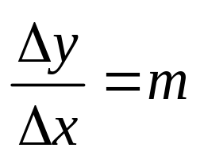
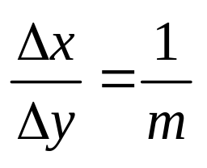
The Digital Differential Analyzer (DDA) Algorithm
means that for a unit (1) change in x there is
m-change in y.
i.e. y = 3x + 1 m = 3
x | y
0 | 1
1 | 4
2 | 7
3 | 10
4 | 13
5 | 16
means that for a unit (1) change in y there is
1/m change in x.

Slide 13
The DDA Method
Uses differential equation of the line : m
If slope |m| ≤ 1 then increment x in steps of 1 pixel and find corresponding y-values.
If slope |m| > 1 then increment y in steps of 1 pixel and find corresponding x-values.
 |  |  |  |  |  | ■ | ■
 |  |  |  | ■ | ■
 |  | ■ | ■
■ | ■
 |  |  | ■
 |  |  | ■
 |  | ■
 |  | ■
 | ■
 | ■
■
■
step through in x
step through in y

Slide 14
. Positive slopes between 0 and 1 will increment the x value by 1. Positive slopes greater than one will increment the y value by
Negative slopes between -1 and 0 will increment the x value by -1, and negative slopes less than -1 will increment the y value by -1

Slide 15
The DDA Method
Desired line
(x_{i}+1,round(y_{i}+m))
(x_{i},y_{i})
(x_{i}+1,y_{i}+m)
(x_{i},round(y_{i}))

Slide 16
void LineDDA(int x0, int y0, int x1, int y1)
{
int dx = x1 – x0, dy = y1 – y0, steps;
if (abs(dx)>abs(dy)) steps = abs(dx);
else steps = abs(dy);
// one of these will be 1 or -1
double xIncrement = (double)dx / (double )steps;
double yIncrement = (double)dy / (double )steps;
double x = x0;
double y = y0;
setPixel(round(x), round(y));
for (int i=0; i<steps; i++) {
{
x += xIncrement;
y += yIncrement;
setPixel(round(x), round(y));
}
}
Note: The DDA algorithm is faster than the direct use of y = mx + c.
It eliminates multiplication; only one addition.

Slide 17
Example
Draw a line from point (2,1) to (12,6)
Draw a line from point (1,6) to (11,0)
7
6
5
4
3
2
1
0
 | 0 | 1 | 2 | 3 | 4 | 5 | 6 | 7 | 8 | 9 | 10 | 11 | 12

Slide 18
Bresenham Line Algorithm
A more efficient approach
Basis of the algorithm:
From start position decide A or B next
 | A
 | B
Start position

Slide 19
Bresenham Line Algorithm
True line
t_{i}
s_{i}
For a given value of x
  one pixel lies at distance t_{i} above the line, and
  one pixel lies at distance s_{i} below the line

Slide 20
Bresenham Line Algorithm
Decision parameter
d_{i} = (s_{i} - t_{i})
If d_{i} < 0, then closest pixel is below true line (s_{i} smaller)
If d_{i} ≥ 0, then closest pixel is above true line (t_{i} smaller)
We must calculate the new values for d_{i} as we move along the line.

Slide 21
Example – Draw a line from (20,10) to (30,18)
(30,18)
dx = 10
dy = 8
initial decision d₀ = 2dy – dx = 6
Also 2dy = 16, 2(dy – dx) = -4
(20,10)
i d_{i} (x_{i+1},y_{i+1})
0 6 (21,11)
1 2 (22,12)
2 -2 (23,12)
3 14 (24,13)
4 10 (25,14)
5 6 (26,15)
6 2 (27,16)
7 -2 (28,16)
8 14 (29,17)
9 10 (30,18)
19
18
17
16
15
14
13
12
11
10
 | 20 | 21 | 22 | 23 | 24 | 25 | 26 | 27 | 28 | 29 | 30 | 31 | 32

Slide 22
void LineBres(int x0, int y0, int x1, int y1) // line for |m| < 1
{
int dx = abs(x1 – x0), dy = abs(y1 – y0);
int d = 2 * dy – dx, twoDy = 2 * dy, twoDyMinusDx = 2 * (dy – dx);
int x, y;
if (x0 > x1) { // determines which point to use as start, which as end
x = x1;
y = y1;
x1 = x0;
}
else {
x = x0;
y = y0;
}
setPixel(x,y);
while (x < x1) {
x++;
if (d < 0) d += twoDy;
else {
y++;
d += twoDyMinusDx;
}
setPixel(x, y);
}
}

Slide 23
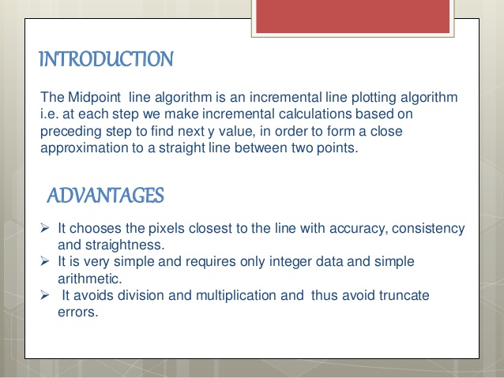

Slide 24
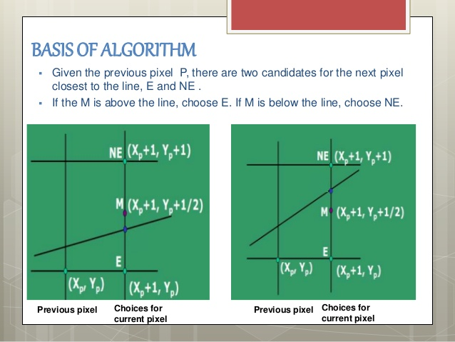

Slide 25
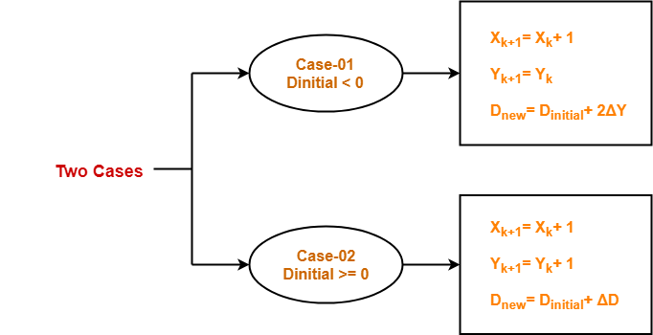

Slide 26
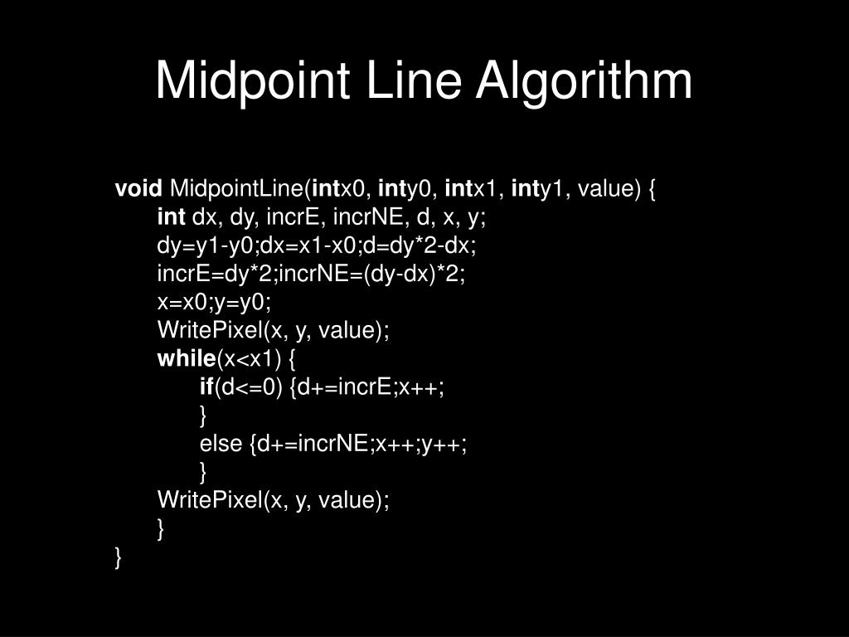

Slide 27
Calculate the points between the starting coordinates (5, 9) and ending coordinates (12, 16).
D_{initial} | D_{new} | X_{k+1} | Y_{k+1}
 |  | 5 | 9
7 | 7 | 6 | 10
7 | 7 | 7 | 11
7 | 7 | 8 | 12
7 | 7 | 9 | 13
7 | 7 | 10 | 14
7 | 7 | 11 | 15
7 |  | 12 | 16

Slide 28
Special cases
Special cases can be handled separately
  Horizontal lines (Δy = 0)
  Vertical lines (Δx = 0)
  Diagonal lines (|Δx| = |Δy|)
directly into the frame-buffer without processing them through the line-plotting algorithms.

